Slide 1
The Tank Game
A presentation of the progress of the project
Developed by:
Bishruti Siku
Nitish Dhaubadel
Iksha Gurung
Pranay Pradhanga
Sandip Sahani

Slide 2
About the project
Development of Multiplayer interactive “Tank” game
Why Tank Game?
Fun and Interactive
Help in developing programming skills
Understanding the game development process
Working as a team and team coordination.

Slide 3
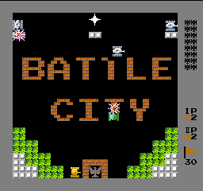
Concept of the game
Based on Nintendo’s 1980 console game BATTLE CITY

Slide 4
Our game
Main Story :
Consists of 4 players, 2 player form a team.
Each team has their seal.
Main objective of the game is to protect your seal and destroy others.
The destroyer wins.

Slide 5
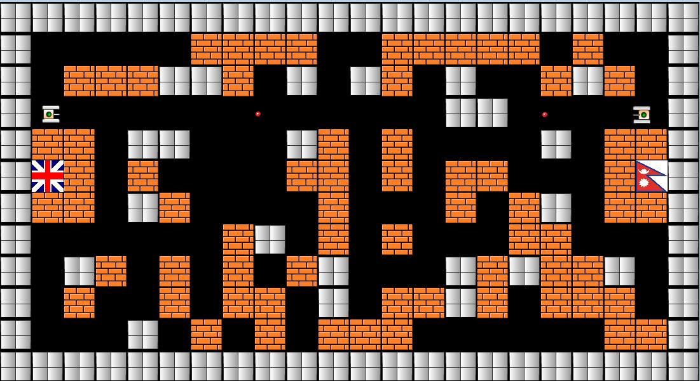
Our game
A Snapshot

Slide 6



Resources used
Resources Used | For
Dev Cpp 4.9.9.2 | A free open source IDE based C/C++ Compiler
Simple Direct media Layer(SDL) | A free open source game development library programmed in C
Microsoft Paint, Macromedia Flash and Adobe Photoshop | Design of Game Graphics
Abyss Wave Editor | Designing and Editing game music and sound effects

Slide 7
Overview of project plan
Division of game development aspects
Five aspects of game development
Weekly evaluation of task completed
TASK COMPLETED
Gantt Chart
TASK REMAINING
TASK WEEK | 1 | 2 | 3 | 4 | 5 | 6 | 7 | 8 | 9 | 10
Game Analysis and Design
Graphics and Sound Programming
File Handling
Event handling and player control
Packaging and testing
Week 1 starts from – March 14, 2010 Project deadline : June 14, 2010

Slide 8
Current gantt chart standings…
Week | Task accomplished
1 | Designed first level of the game
2 | Created graphics for game Worked on collision detection
3 | Collision detection continued. File handling to read the level file. Introduced bullets
4 | Bullets destroying the wall Collision detection continued.
5 | Successful Implemented Collision detection. Created welcome screen for the game
6 | Finally able to resolve the inter player collision issue. Added sound and music to the game.

Slide 9
Major Task Accomplished so far…
Design of a level map.
Firing bullets and destruction of objects
Main welcome screen
Collision detection

Slide 10
Level Map
Store the information of a particular game level in a file.
Load a particular level from the file using file-handling.
Provides user with the option to play at different levels.
011011011011000111110101010101011110
LOAD
LEVEL FILE
LEVEL INFORMATION
GAME LEVEL

Slide 11




Sample Level File
1 1 1 1 1 1 1 1 1 1 1 1 1 1 1 1 1 1 1 1 1 1
1 0 0 0 0 0 2 2 2 2 0 0 2 2 2 2 2 0 2 0 0 1
1 0 2 2 2 1 1 2 0 1 0 1 2 0 1 0 0 2 1 2 0 1
1 0 0 2 2 0 0 0 0 2 0 0 0 0 1 1 0 2 0 0 0 1
1 2 2 0 1 1 0 0 0 1 2 0 2 0 0 0 0 1 0 2 2 1
1 6 2 0 2 0 0 0 0 2 2 0 2 0 2 2 0 0 0 2 5 1
1 2 2 0 1 2 0 0 0 0 2 0 0 0 2 0 2 1 0 2 2 1
1 0 0 0 0 0 0 2 1 0 2 0 2 0 0 0 2 2 0 0 0 1
1 0 1 2 0 2 0 2 0 2 1 0 0 0 1 2 1 2 2 1 0 1
1 0 2 0 0 2 0 2 2 0 1 0 2 2 1 2 0 2 2 2 0 1
1 0 0 0 1 0 2 0 2 0 2 2 2 0 0 0 0 0 0 2 2 1
1 1 1 1 1 1 1 1 1 1 1 1 1 1 1 1 1 1 1 1 1 1
WALL
PLAYER 1 SEAL
PLAYER 2 Seal
EMPTY SPACE
BRICK
Information in level file

Slide 12

Firing Bullets
Each player is assigned a bullet to fire.
One bullet can be fired at one time.
The collision of bullet with :-
Player – Kills the Player
Wall – Nothing happens
Bricks – Bricks cracks, on three hits it explodes
Seal – Same as Bricks
A PLAYER FIRING BULLET TO A WALL
BULLET

Slide 13
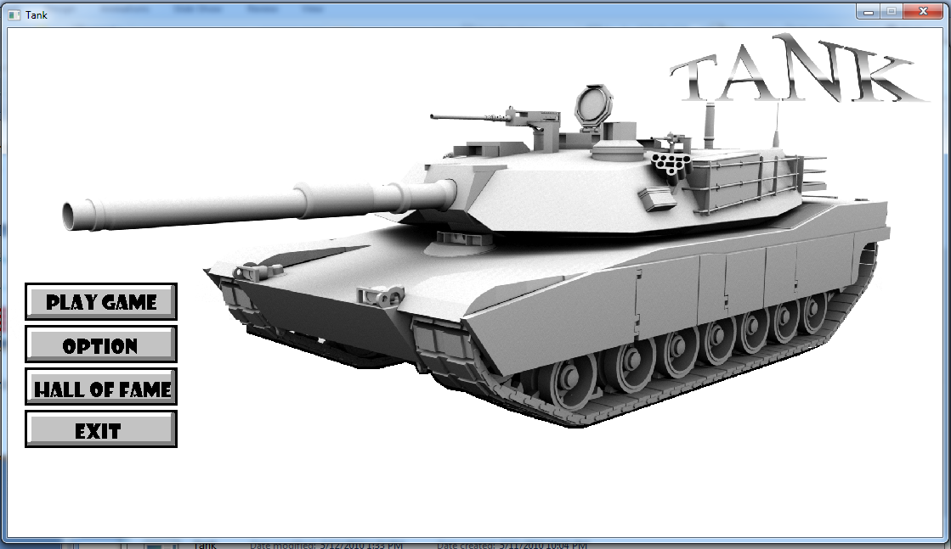
Welcome Screen
The main welcome screen for the game
To provides user with various game play options.
Interfaced with buttons, uses mouse click for response.
Snapshot of main welcome screen

Slide 14
Collision Detection
Collision()
B
A
COLLISION DETECTED
Check_Player_Collision()
Check_Collision()
B
A
B
A
COLLISION DETECTED
OBJECT B is detected
Object B is returned.

Slide 15
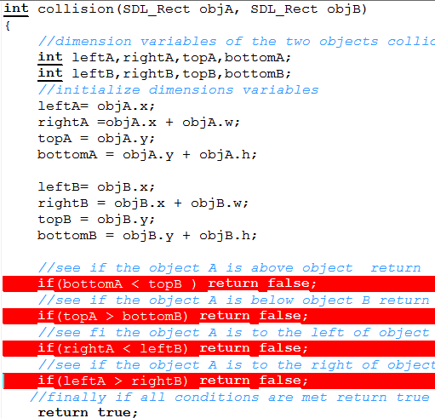
Collision Detection
Objects for which collision is to be detected
Determine the dimension of each objects
Conditions for collision detection
Collision detected

Slide 16
Collision Detection
It was a major problem in the game development process.
In Game, the collision is detected using following 3 main functions
Function name | Purpose | Returns
Collision(object A, Object B) | The main purpose of the function is to detected collision between given two objects | True or False
Check_Collision(Object A , Direction) | It checks if object A encounters any object in the direction specified | Returns the first object that is located in the specified direction
Check_Player_Collision(Player 1 , Player 2, Direction) | Check whether the two players are colliding in the given direction | True or False

Slide 17
Tasks Remaining
Incorporate two more users for the completion of the game central idea.
Add some minute special effects to game. Like bullet fire.
Implement Score management and Hall of Fame using file handling.
Add more feature to the welcome screen. Like Sounds and Controls setup.
Enable two players and four players game play mode.

Slide 18
Thank you…
Any questions?

